Slide 1
Introduction to pathogen sequencing on the Illumina platform
Laboratory Module

Slide 2
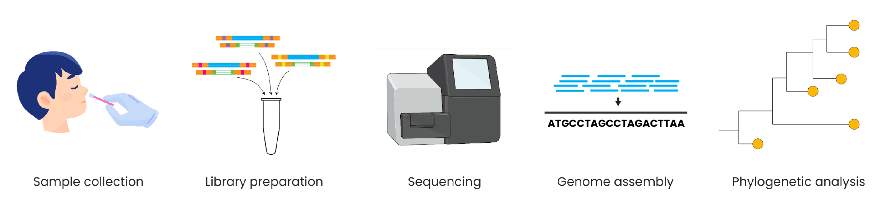
Genomic epidemiology workflow
BioRender.com
Pixel True https://www.pixeltrue.com/about, CC BY-SA 4.0, via Wikimedia Commons

Slide 3
Outline
Using pathogen genomes for epidemiology
Sequencing approaches
Unbiased vs targeted approaches
Sequencing technologies
Brief overview of sequencing platforms
Illumina sequencing

Slide 4
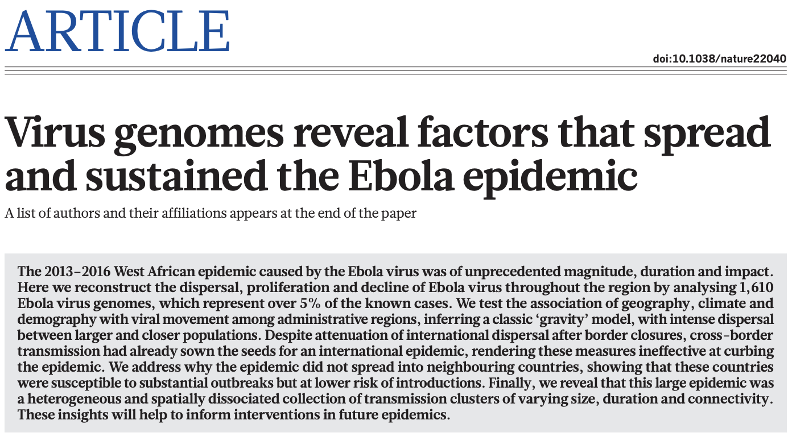
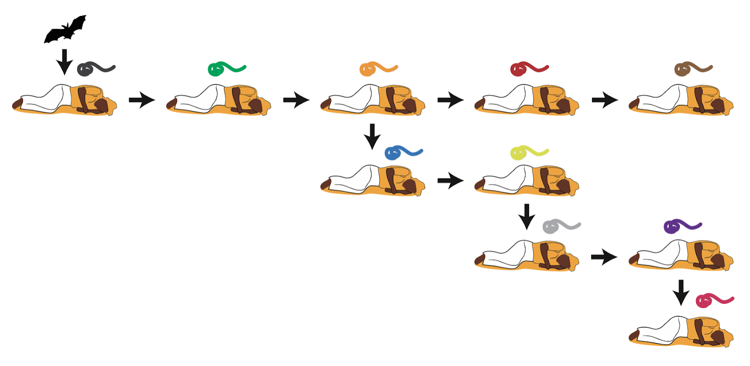
Using pathogen genomes for epidemiology
DNA sequencing is increasingly used for infectious disease surveillance and to answer public health questions
Genomic epidemiology uses the mutations that appear over time in pathogen genomes to infer the likely spread and incidence of a pathogen

Slide 5
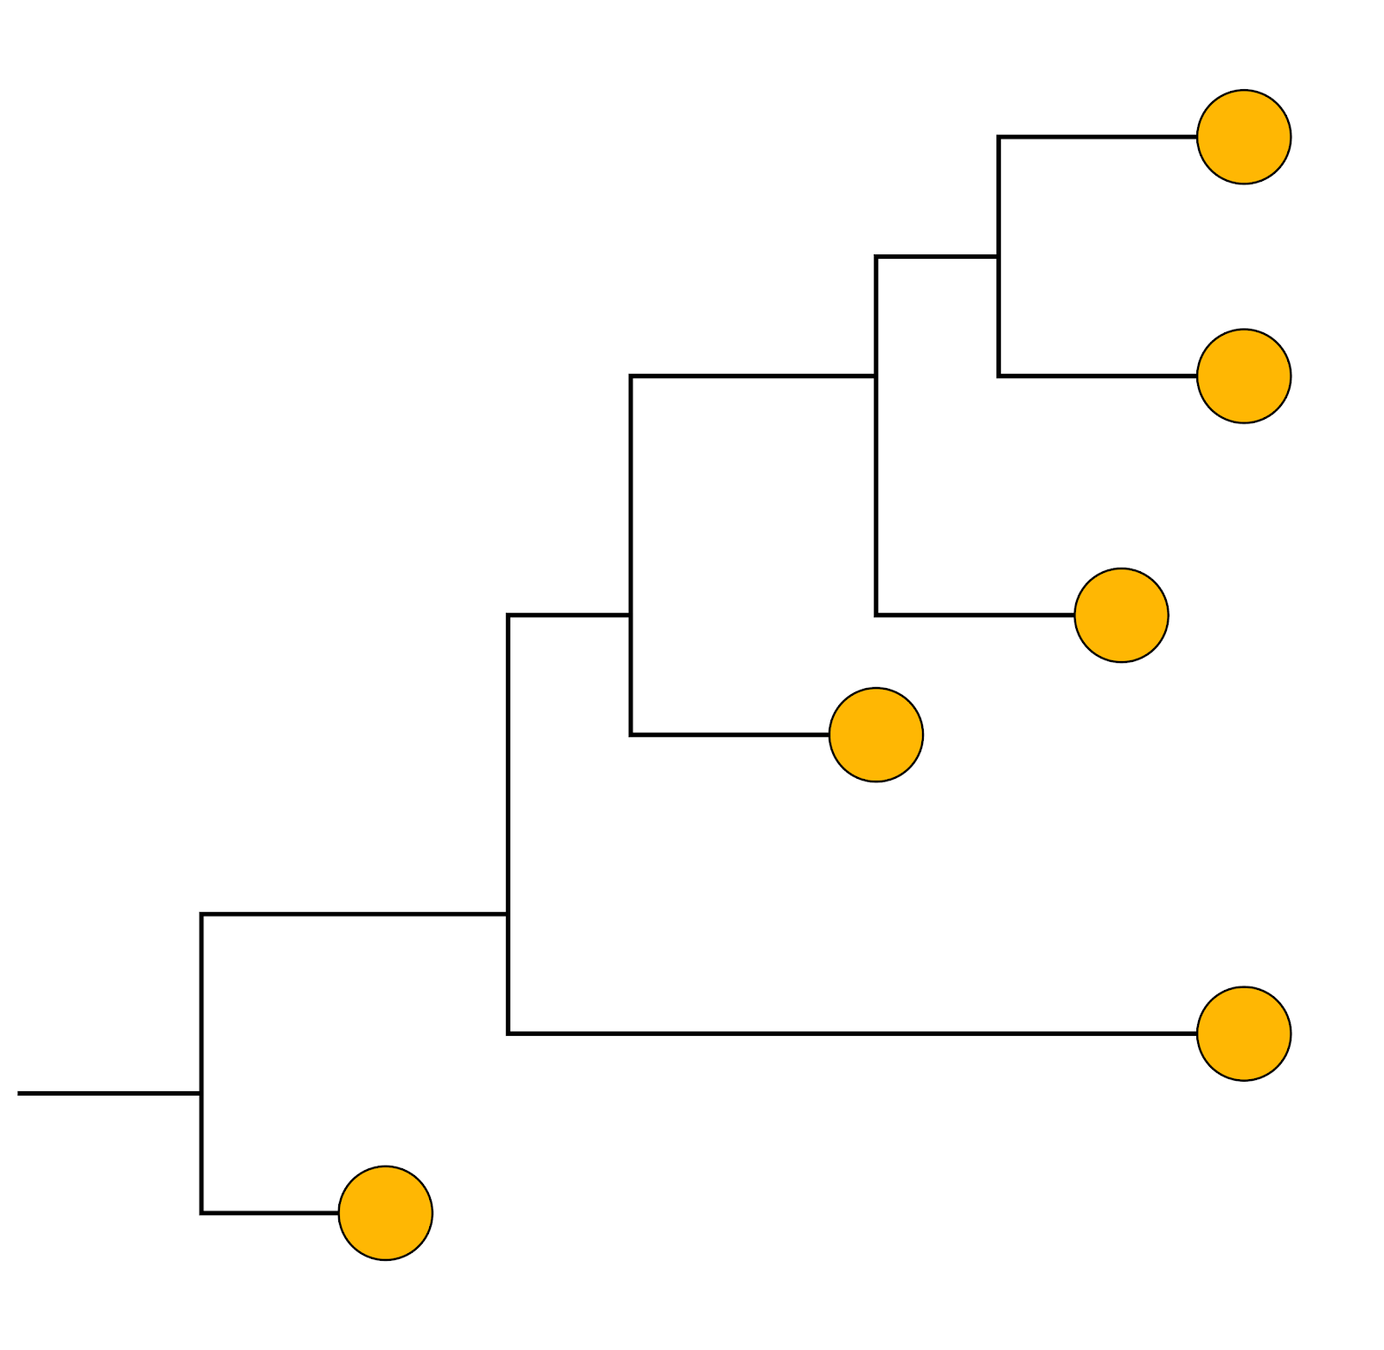
Using pathogen genomes for epidemiology
Phylogenetic tree
DNA sequencing is increasingly used for infectious disease surveillance and to answer public health questions
Genomic epidemiology uses the mutations that appear over time in pathogen genomes to infer the likely spread and incidence of a pathogen

Slide 6
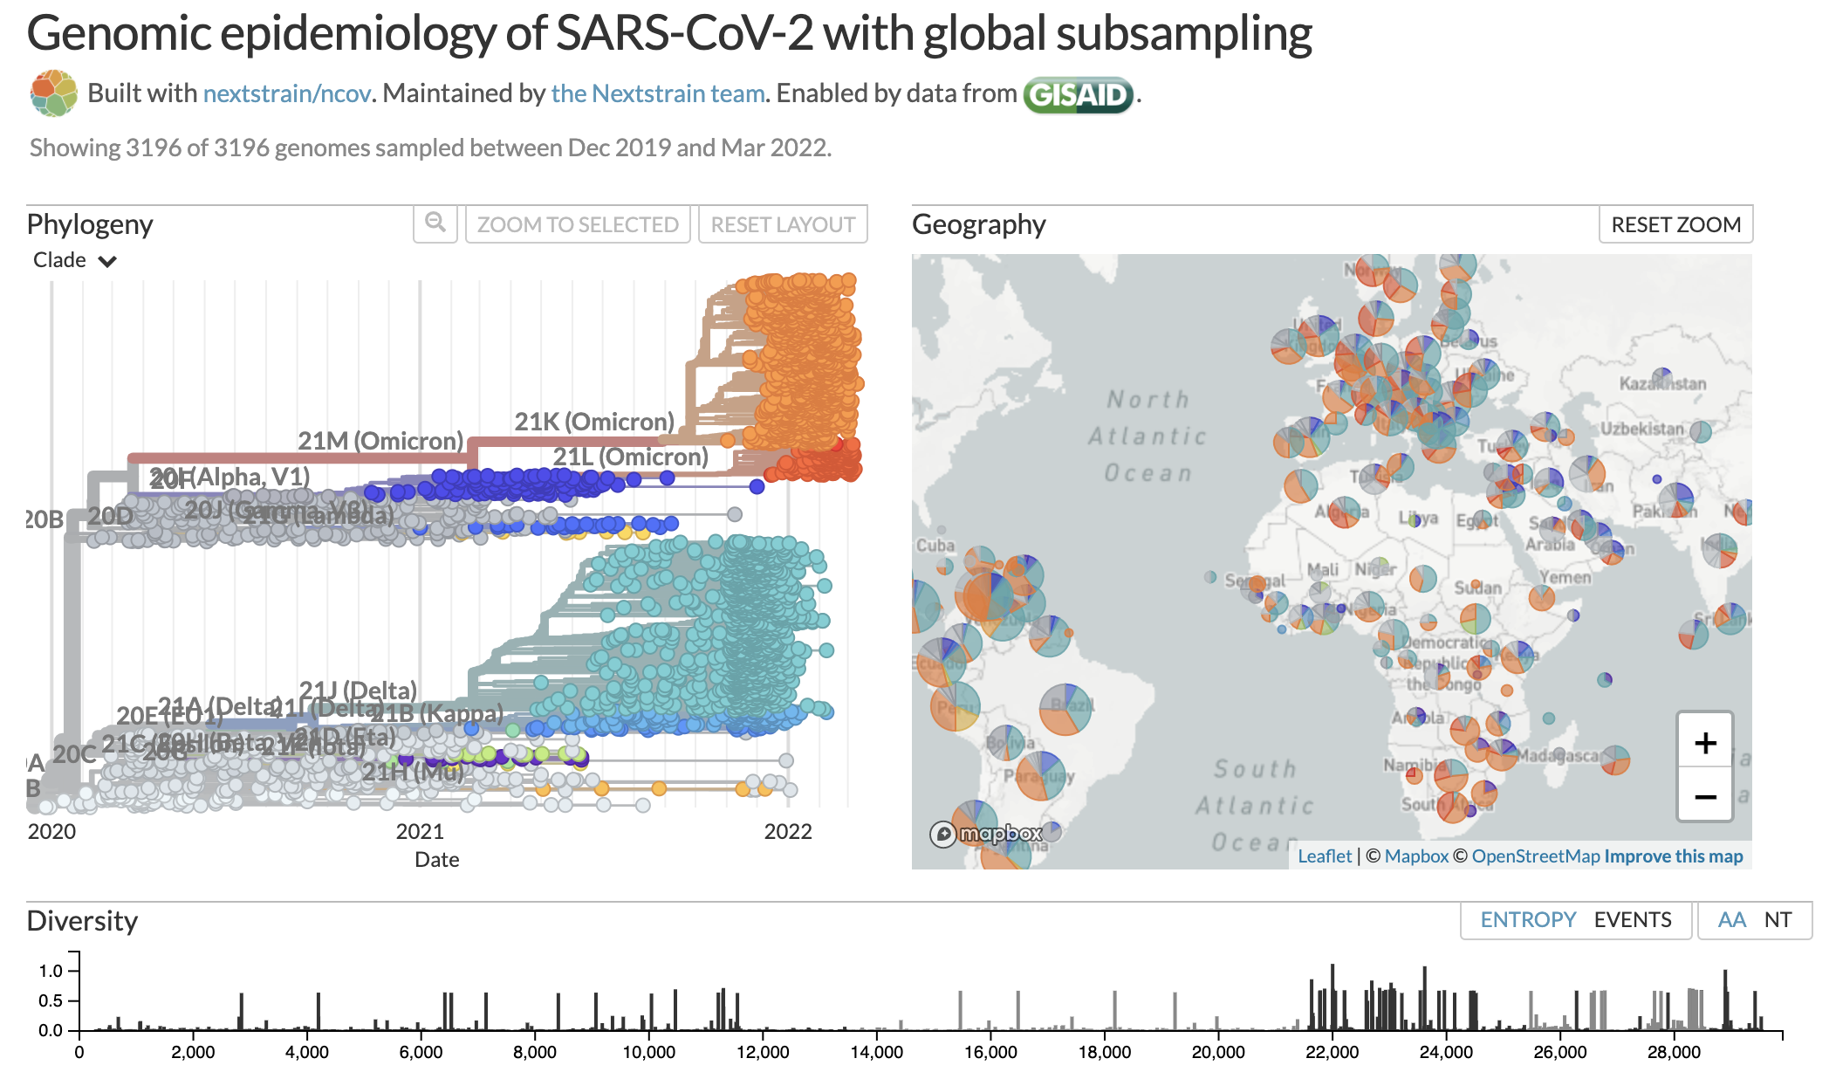
Using pathogen genomes for epidemiology
https://nextstrain.org/ncov/global
Analyze and interpret genome sequences with support of real time, scalable tools

Slide 7
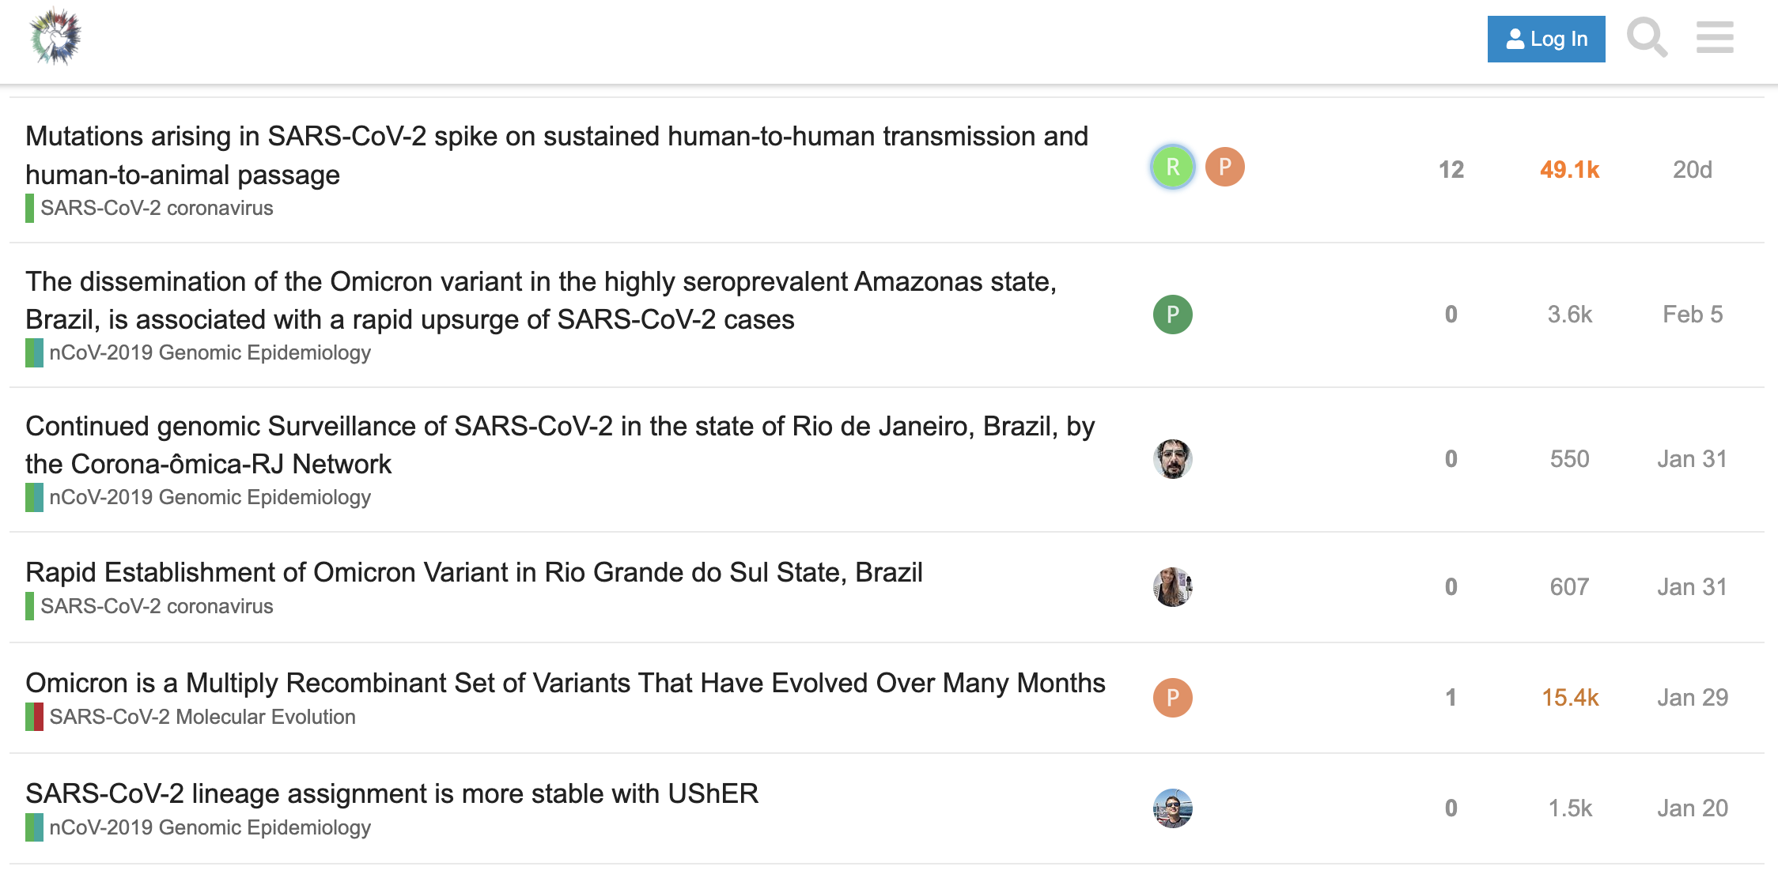


Using pathogen genomes for epidemiology
https://virological.org
Share sequences and interpretation through online platforms

Slide 8
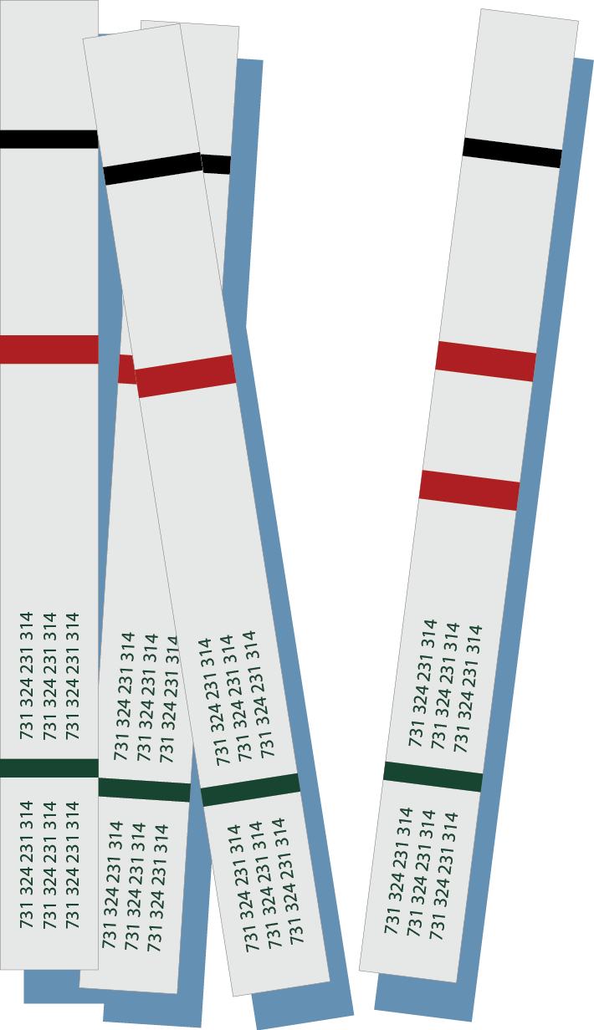
Using pathogen genomes for epidemiology
Other methods for molecular characterization of pathogens:
Rapid diagnostic tests
PCR-based assays / CRISPR-based assays

Slide 9
Using pathogen genomes for epidemiology
Other methods for molecular characterization of pathogens:
Rapid diagnostic tests
PCR-based assays / CRISPR-based assays
ATGCAGCTAGCTGATGCTGACTGACTGACTGCTGATTCGCTAATCGTACCTCGACGATCAT

Slide 10
Using pathogen genomes for epidemiology
Other methods for molecular characterization of pathogens:
Rapid diagnostic tests
PCR-based assays / CRISPR-based assays
Multi-locus variable typing (MLVA) – bacterial genomes
Multi-locus sequence typing (MLST) – bacterial genomes
Single amplicon sequencing – e.g., 16S for bacteria or marker gene for viruses
ATGCAGCTAGCTGATGCTGACTGACTGACTGCTGATTCGCTAATCGTACCTCGACGATCAT

Slide 11
Using pathogen genomes for epidemiology
Other methods for molecular characterization of pathogens:
Rapid diagnostic tests
PCR-based assays / CRISPR-based assays
Multi-locus variable typing (MLVA) – bacterial genomes
Multi-locus sequence typing (MLST) – bacterial genomes
Single amplicon sequencing – e.g., 16S for bacteria or marker gene for viruses
ATGCAGCTAGCTGATGCTGACTGACTGACTGCTGATTCGCTAATCGTACCTCGACGATCAT
Full length pathogen genomes provide the most comprehensive picture of pathogen variation

Slide 12
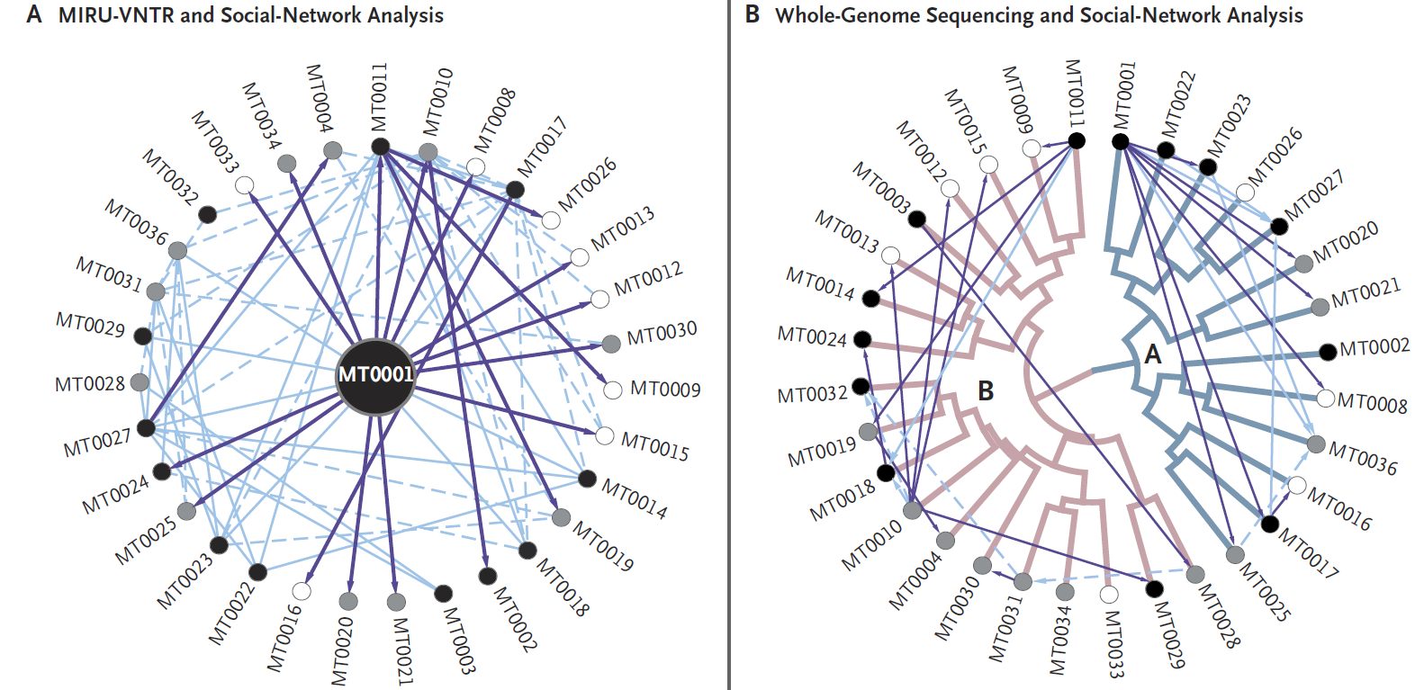
Using pathogen genomes for epidemiology
Gardy et al. 2011 NEJM
Full length pathogen genomes provide the most comprehensive picture of pathogen variation

Slide 13
Outline
Using pathogen genomes for epidemiology
Sequencing approaches
Unbiased vs targeted approaches
Sequencing technologies
Brief overview of sequencing platforms
Illumina sequencing

Slide 14
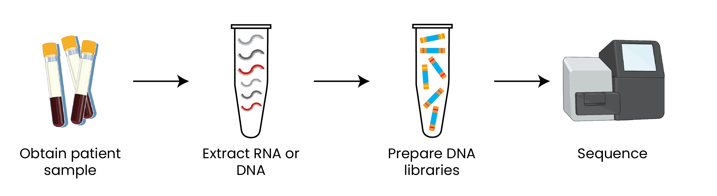
How can we generate pathogen sequences?
There are many options & variations for each of these steps
Your sample type, study goal and & resources should guide your choice
Created with BioRender.com

Slide 15
How can we generate pathogen sequences?
Many kits and methods available to extract RNA and/or DNA
Include precipitation, column-based, and bead-based methods
Your starting material will impact what you can sequence
Many viruses (e.g., Lassa, Ebola, SARS-CoV-2) have RNA genomes
Created with BioRender.com
Notes:
Add biorender citation?

Slide 16
How can we generate pathogen sequences?
*
Many different approaches for preparing DNA libraries
* If you are starting with RNA you will need to convert this to cDNA before preparing DNA libraries
Created with BioRender.com

Slide 17
How can we generate pathogen sequences?
Many different approaches for preparing DNA libraries
Sensitivity, speed
Unbiased, accuracy
Metagenomic sequencing
Amplicon-based sequencing
Created with BioRender.com

Slide 18
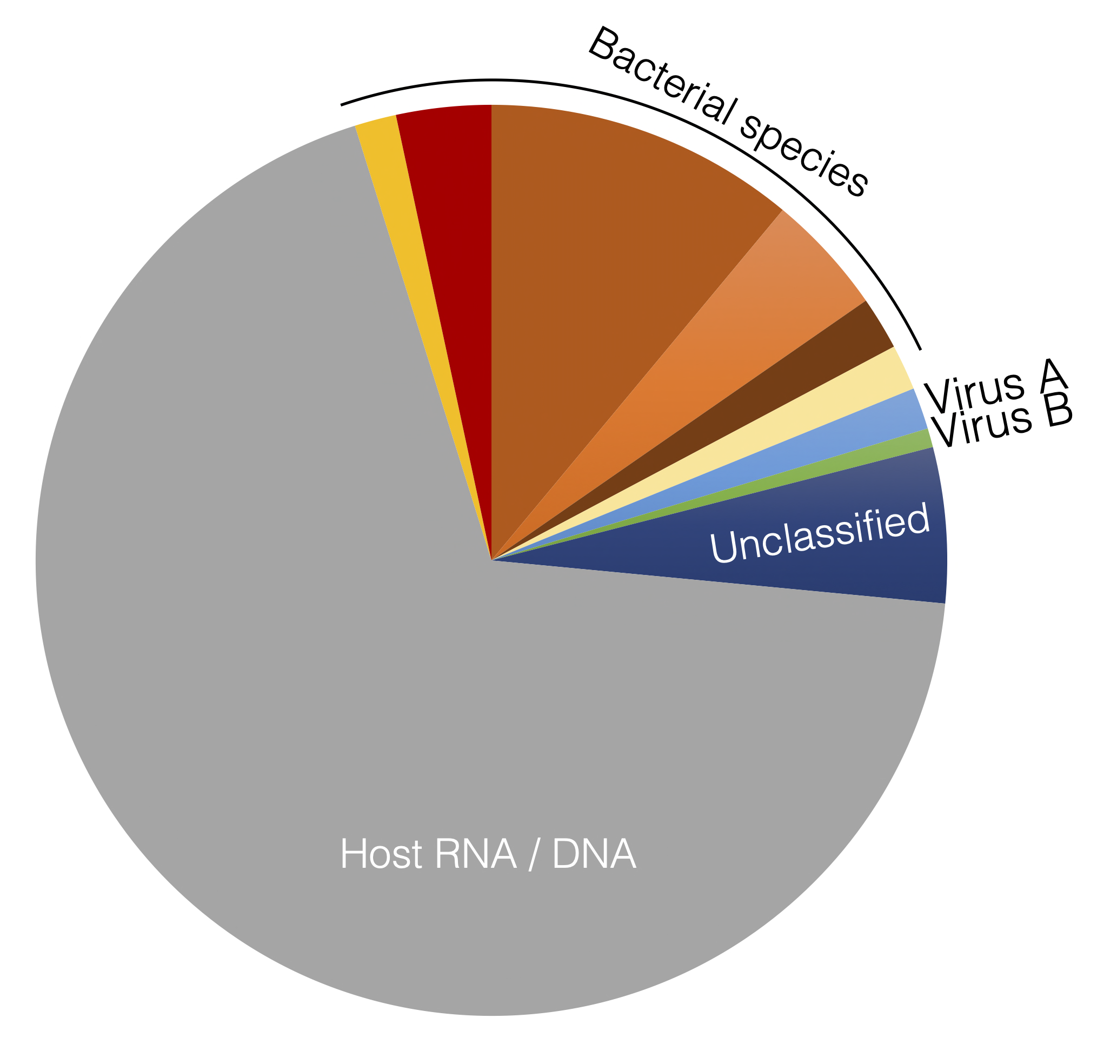
Overview of sequencing approaches
Unbiased (sometimes called metagenomic) sequencing captures all genetic material in a sample
Does not require prior knowledge of what organisms are in the sample
More expensive and requires more time than many targeted sequencing approaches
Sensitivity, speed
Unbiased, accuracy
Metagenomic sequencing
Amplicon-based sequencing

Slide 19
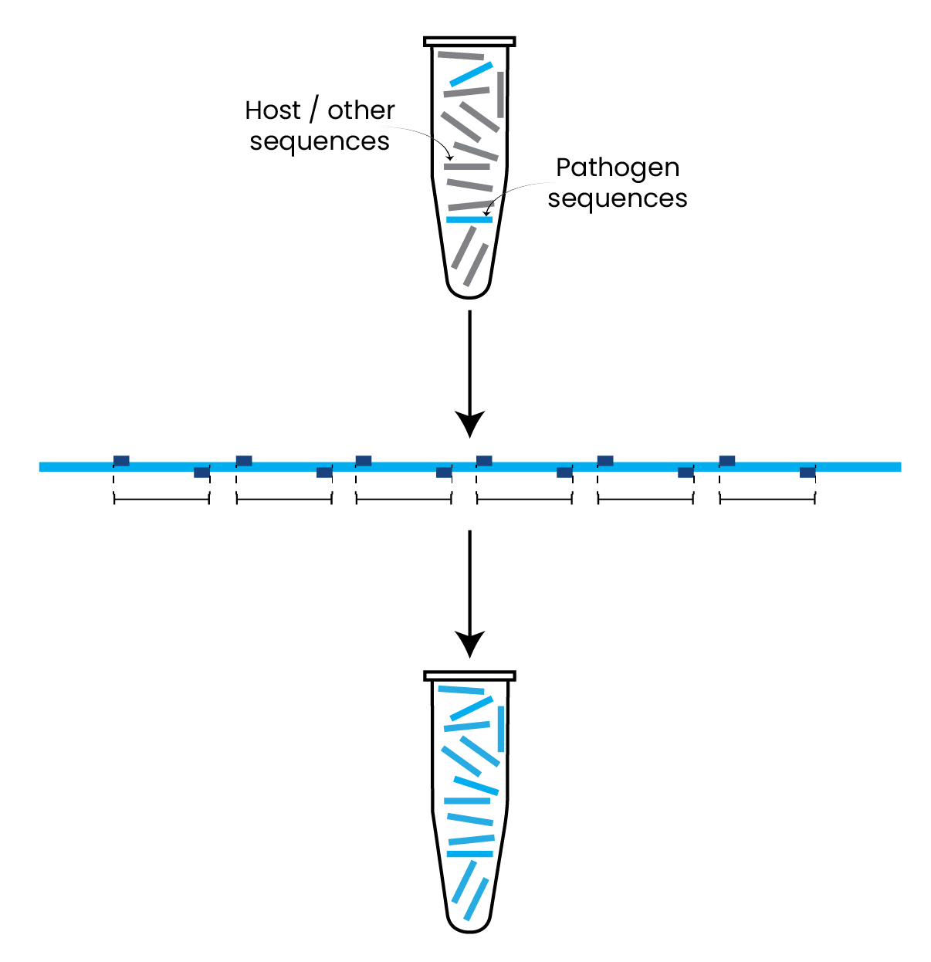
Overview of sequencing approaches
Uses primers to specifically amplify genome of interest (usually in many overlapping short pieces)
More sensitive, especially for low-input samples. Faster and cheaper than unbiased methods
Requires prior knowledge of the target pathogen and its genome sequence.
Can be susceptible to contamination and PCR bias
Sensitivity, speed
Unbiased, accuracy
Metagenomic sequencing
Amplicon-based sequencing

Slide 20
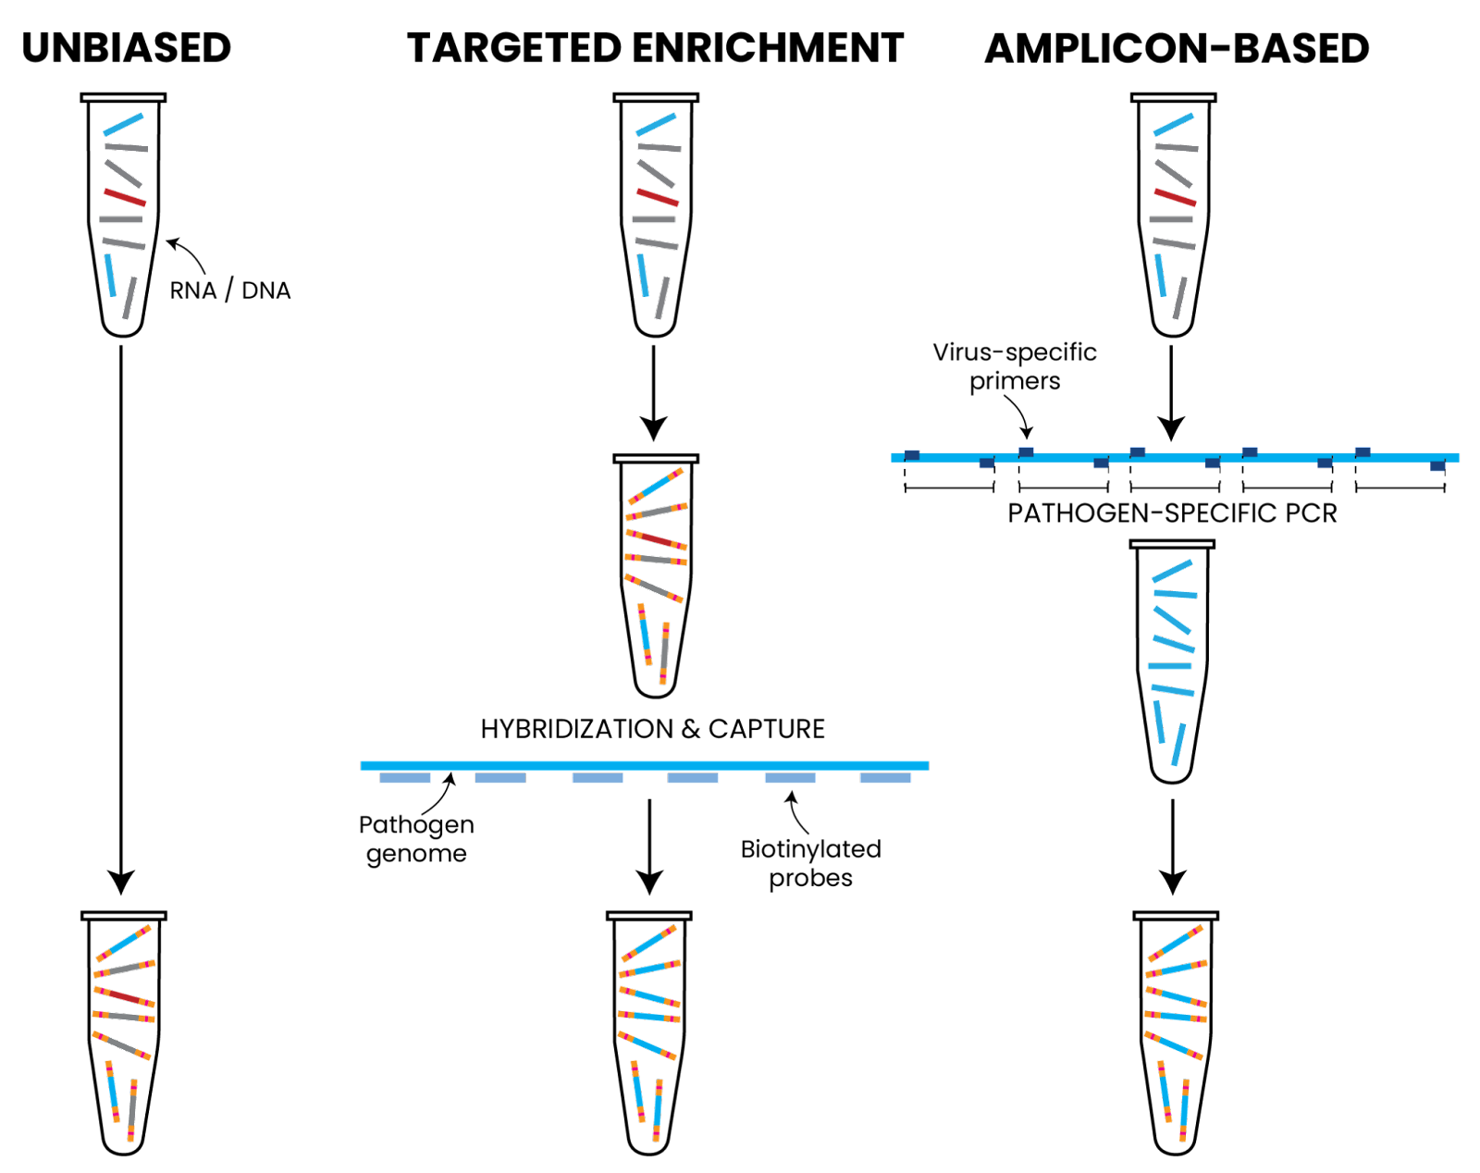
Overview of sequencing approaches
Sensitivity, speed
Unbiased, accuracy
Metagenomic sequencing
Amplicon-based sequencing

Slide 21
Considerations for selecting an approach
Do you know what pathogen you are looking for?
Are you looking for one pathogen or many?
Is this pathogen well-described (e.g., published genomes)?
Do you know what the viral load in your sample is (e.g., Ct value)?
What is the goal of your study (e.g., phylogenetics or just detection)

Slide 22
Outline
Using pathogen genomes for epidemiology
Sequencing approaches
Unbiased vs targeted approaches
Sequencing technologies
Brief overview of sequencing technologies
Illumina sequencing

Slide 23
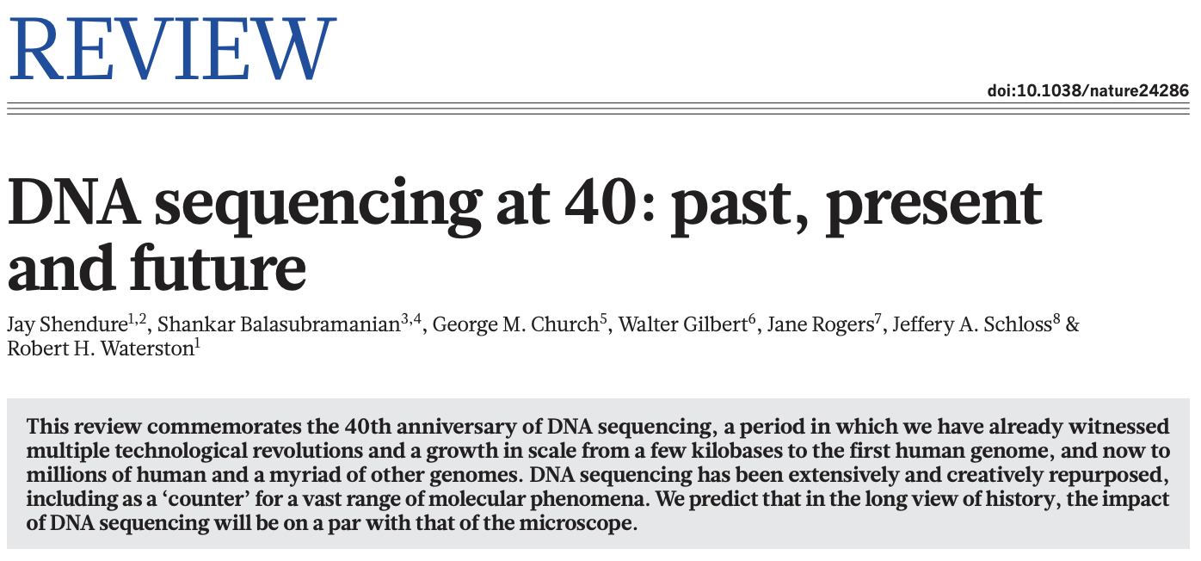
How can we generate pathogen sequences?
Created with BioRender.com

Slide 24
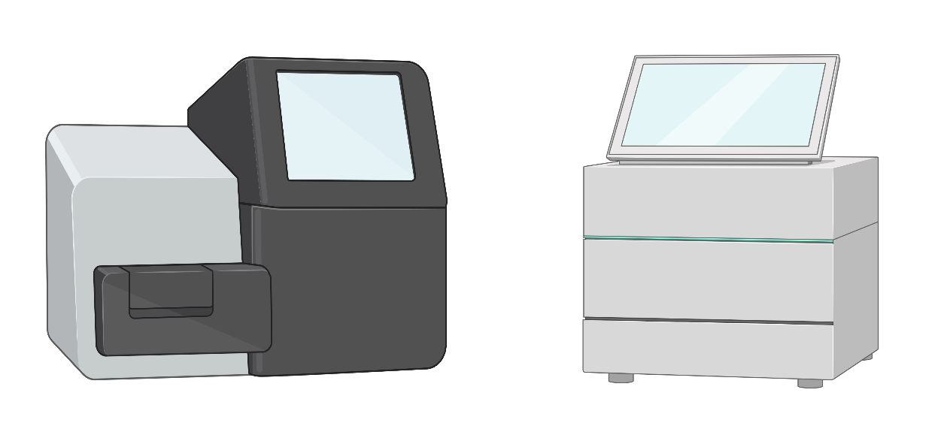
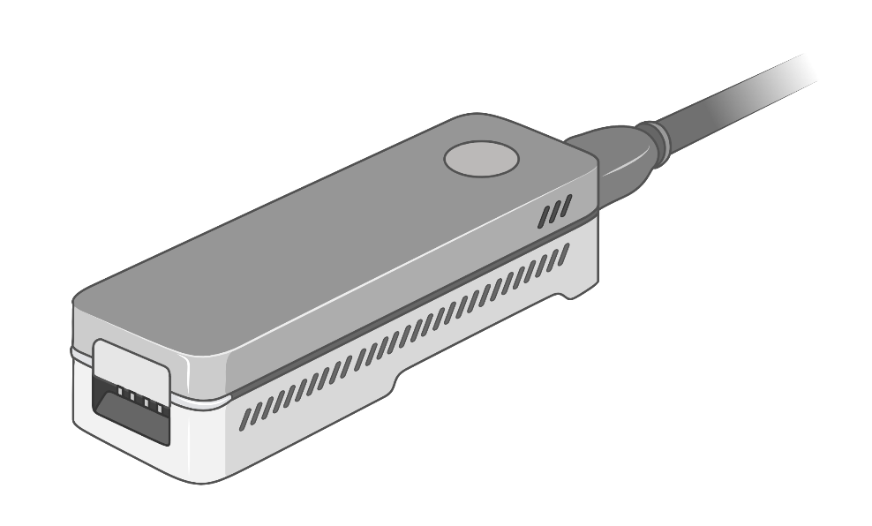
Which technology should I use to sequence?
Massively parallel sequencing
(”next” or “second” generation sequencing)
High throughput (millions or billions of reads)
Short reads (<500nt “read” per DNA module)
High fidelity
Large, expensive, and sensitive machines
Example platforms:
Roche 454, Illumina, Ion Torrent
Single molecule sequencing
(also called “long read” sequencing)
Medium throughput, optimized for real-time
Long reads (>100kb possible)
Medium fidelity
Low cost, portable machines
Example platforms:
Oxford Nanopore, PacBio
Created with BioRender.com

Slide 25
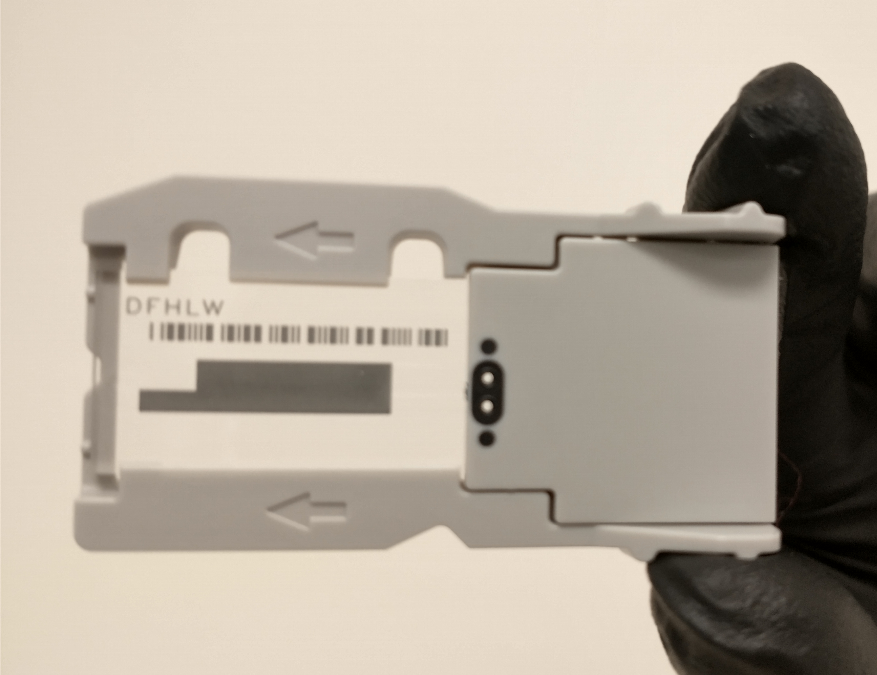
Illumina sequencing: how it works
MiSeq V2 Nano flowcell

Slide 26
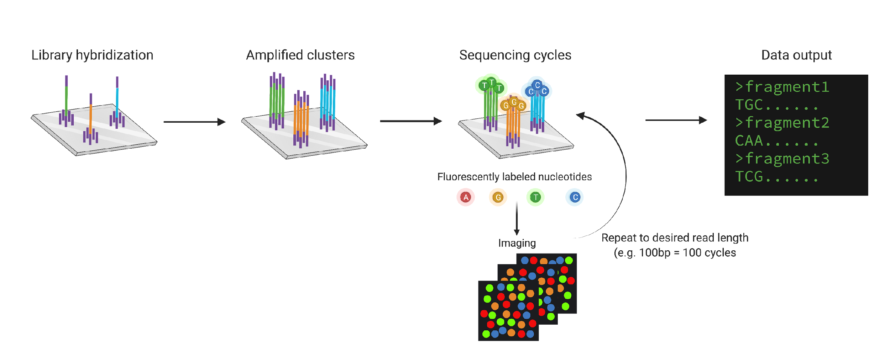
Illumina sequencing: how it works
Short DNA fragments bind to oligos on the surface of the flowcell
Created with BioRender.com

Slide 27
Illumina sequencing: how it works
“Bridge amplification” makes many copies of a fragment to amplify signal (cluster)
Created with BioRender.com

Slide 28
Illumina sequencing: how it works
Labelled nucleotides are washed over the flowcell and incorporated where they reflect the next base in the sequence
The flowcell is imaged to determine which nucleotide was incorporated in each cluster before the process begins again
Created with BioRender.com

Slide 29
Illumina sequencing: how it works
Fluorescent intensities are converted to base calls and output for analysis
Created with BioRender.com

Slide 30
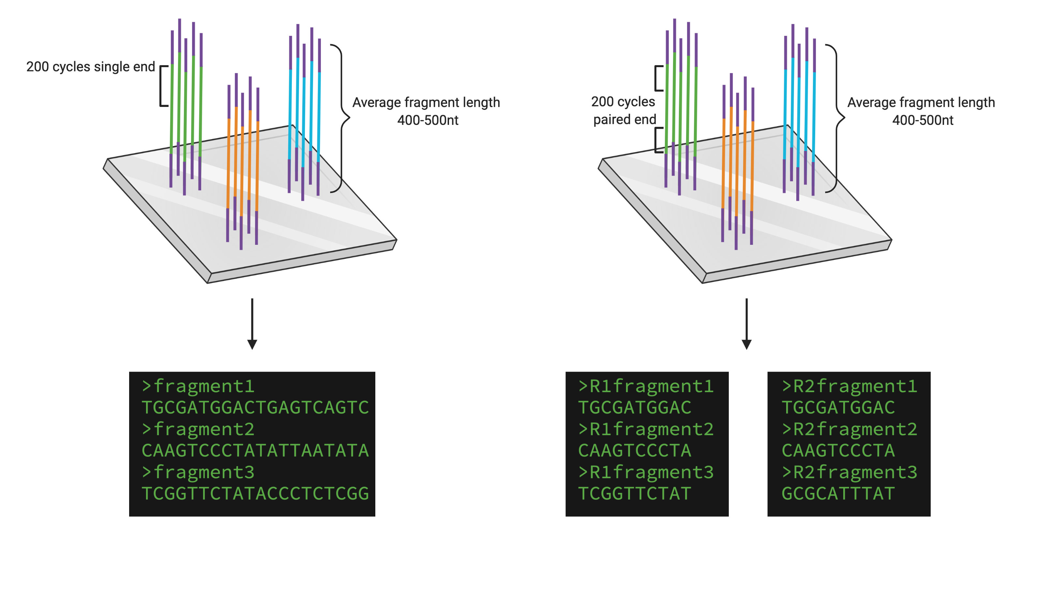
Illumina sequencing: how it works
Created with BioRender.com

Slide 31
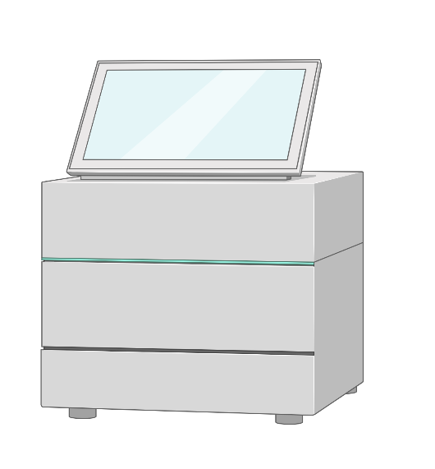
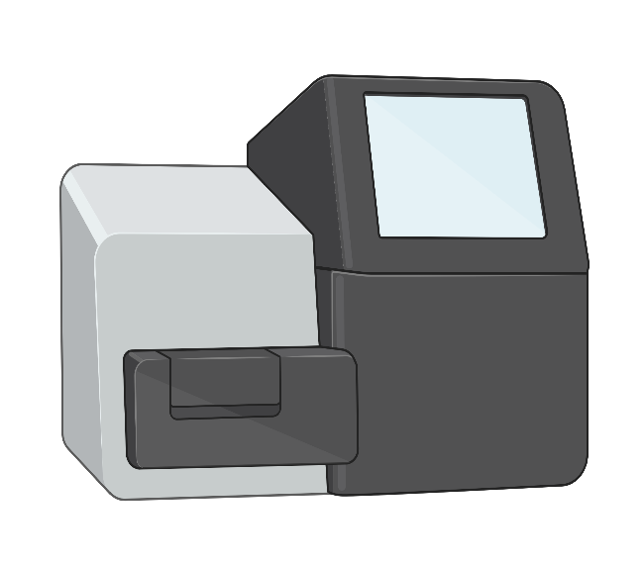
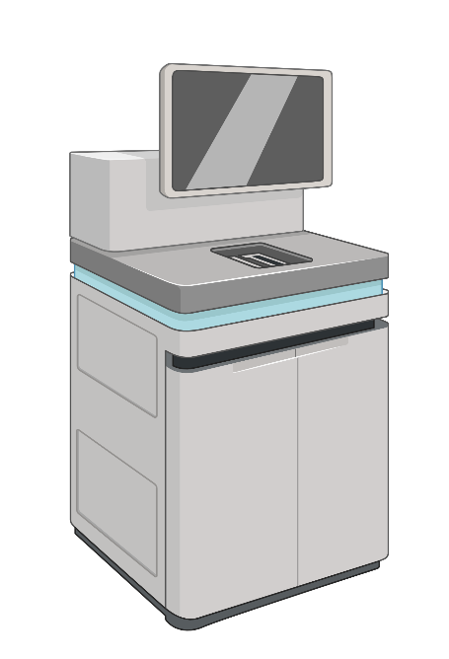
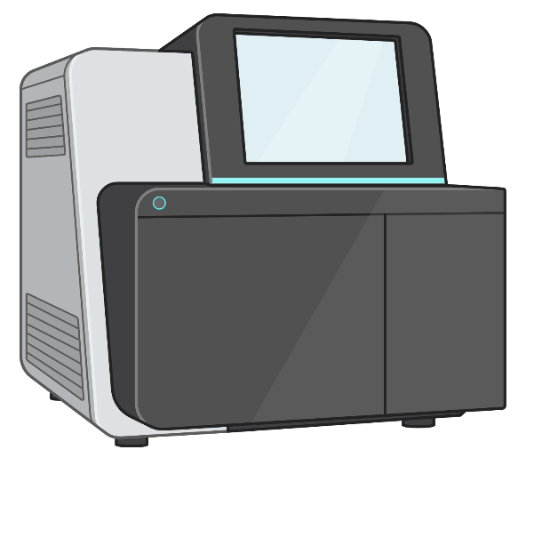
Range of instruments on the Illumina platform
Benchtop box
Large, free-standing
Pool 10s of samples
Pool 1000s of samples
$100s per run
$10,000s per run
Created with BioRender.com

Slide 32
iSeq and MiSeq are widely used for pathogens
iSeq
MiSeq
Up to 4 million reads per run
9.5 – 19 hours to run
Up to 2x150 bp reads
Kits cost $500-$600 USD
5-25 million reads per run
4-48 hours to run
Up to 2x300 bp reads
Kits cost $1,000-$1,400 USD
Created with BioRender.com

Slide 33
Summary
Pathogen genomes give us more complete information for inferring epidemiology than other molecular tools
When deciding how to sequence a sample we need to select an approach as well as a sequencing platform
Illumina sequencing is a widely used platform for pathogen sequencing at medium to high throughput

